Slide 1
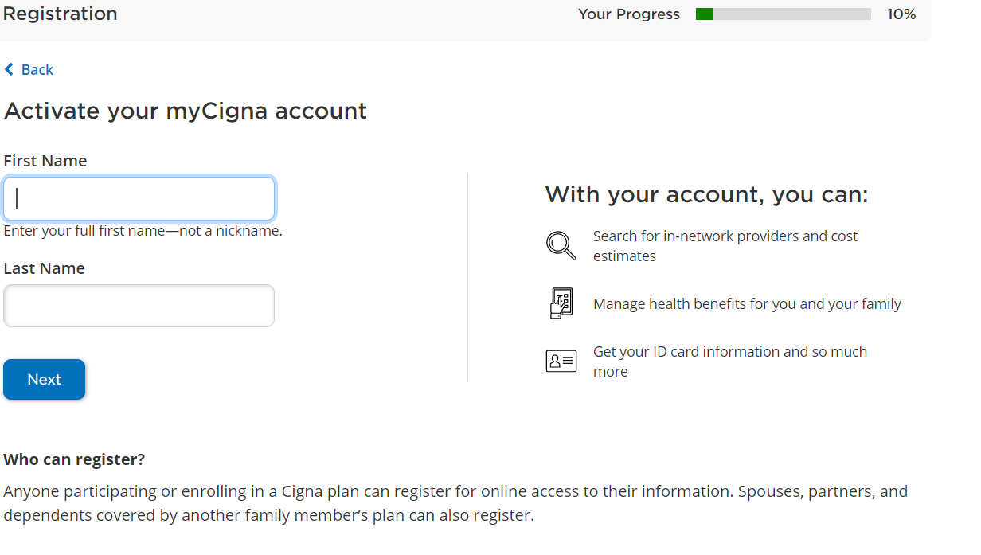
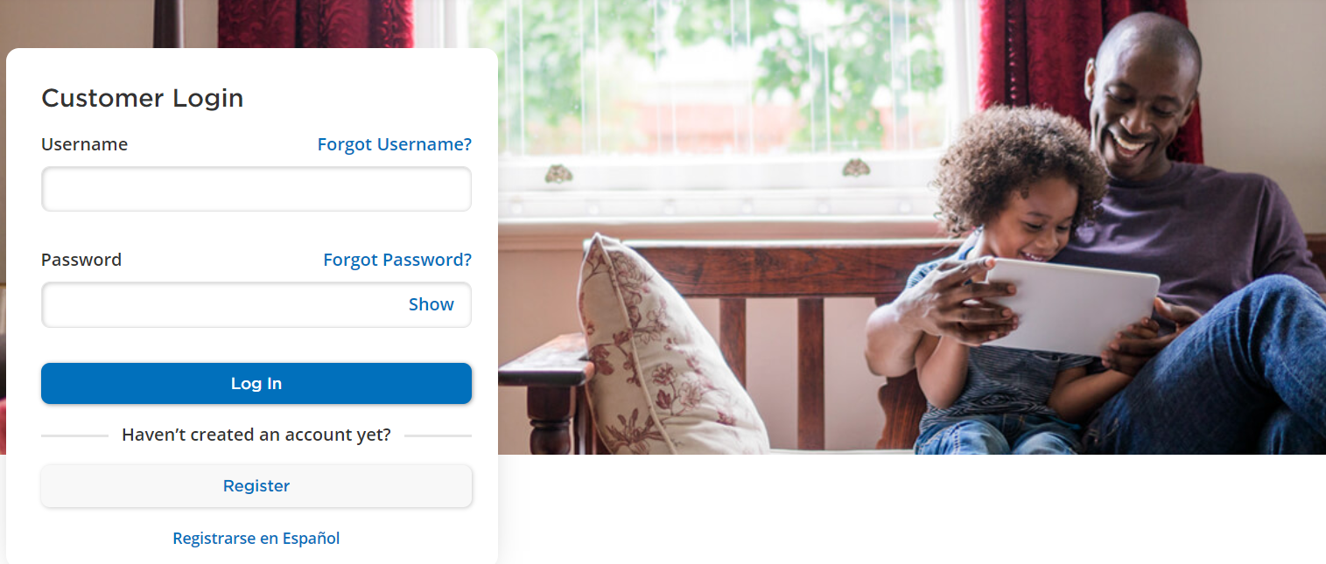
MyCigna Screenshots for St. Peter’s Health
If you have an existing MyCigna account, simply log in using your username and password
If you do not have a MyCigna account, you will need to complete a one-time registration

Slide 2
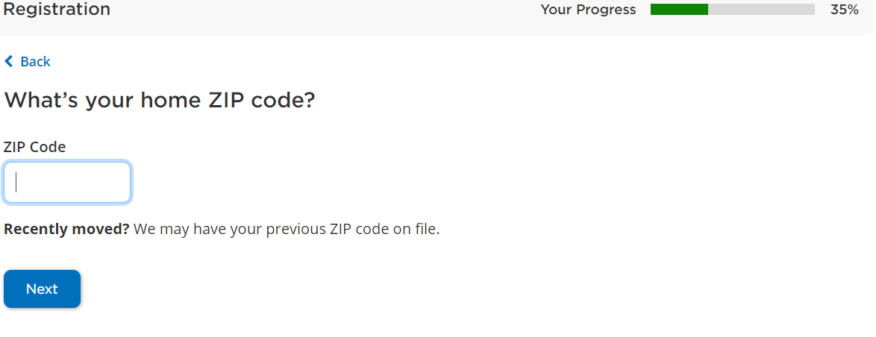
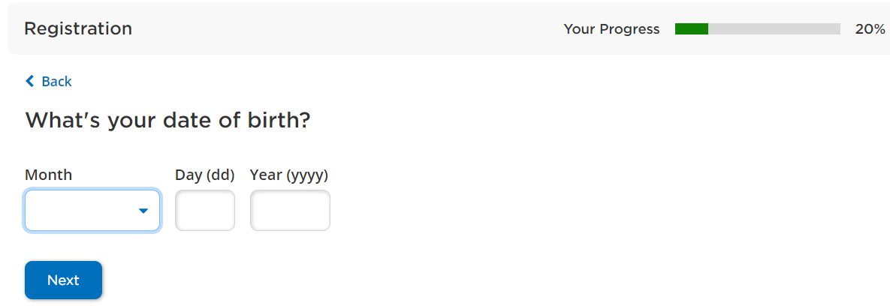
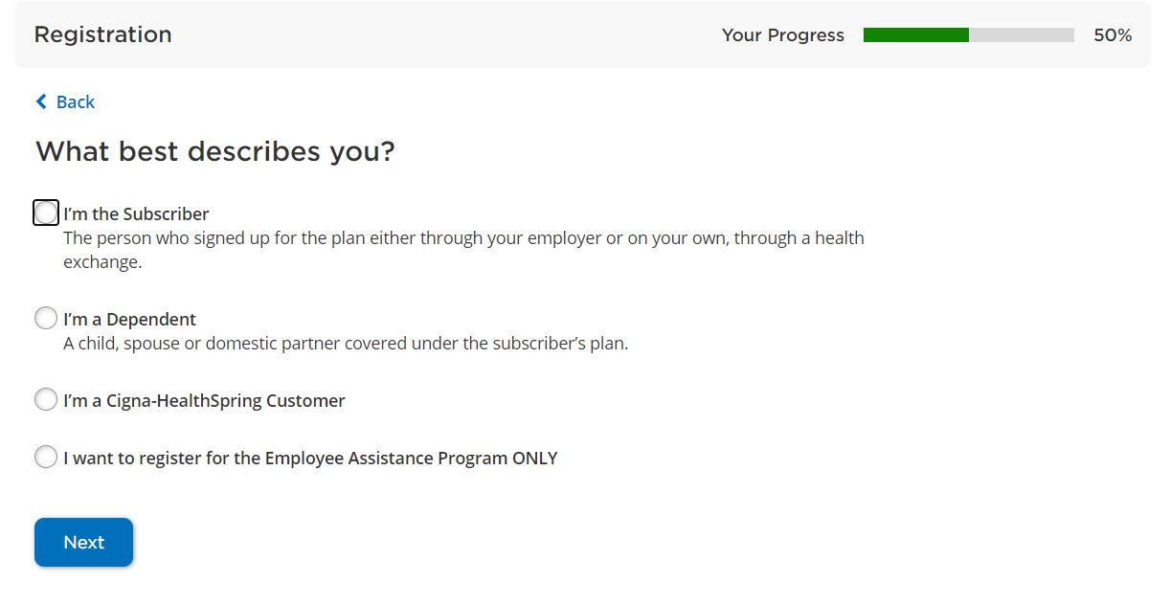
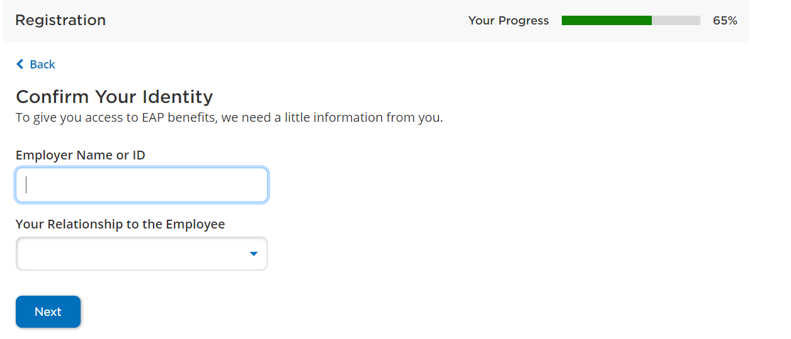
Registration Information
Enter your Date of Birth and Zip Code
Enter the Employer ID: stpetershealth and note whether you are the employee or household member of the SPH employee
Select ‘I want to register for the Employee Assistance Program ONLY’

Slide 3
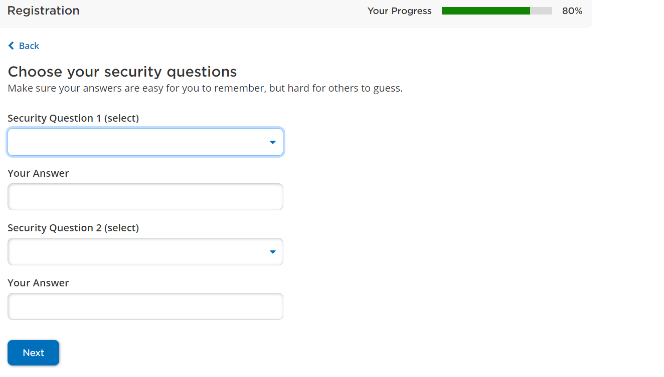
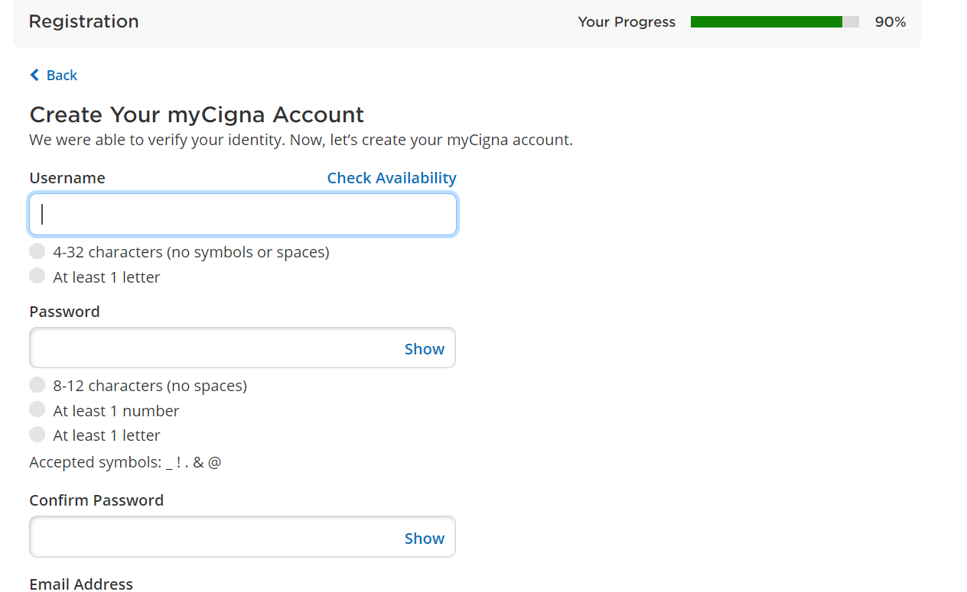
Registration Information Continued
Select your security questions
Create your username and password for future log ins. You will also need to enter a valid email address
Once you create your username and password, you will automatically be logged into MyCigna

Slide 4
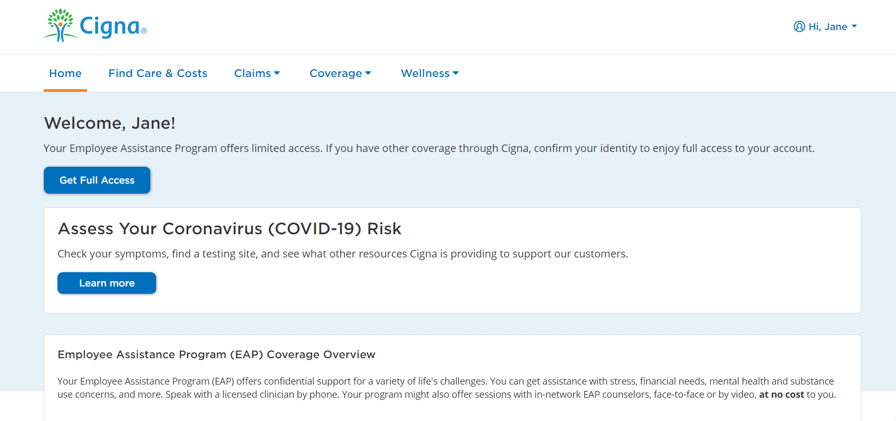
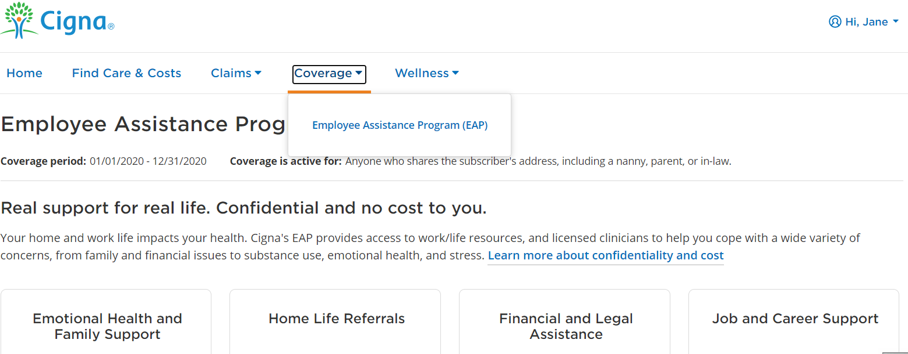
MyCigna Home Page and EAP Landing Page
Under Coverage, Select Employee Assistance Program (EAP)
MyCigna Home Page

Slide 5
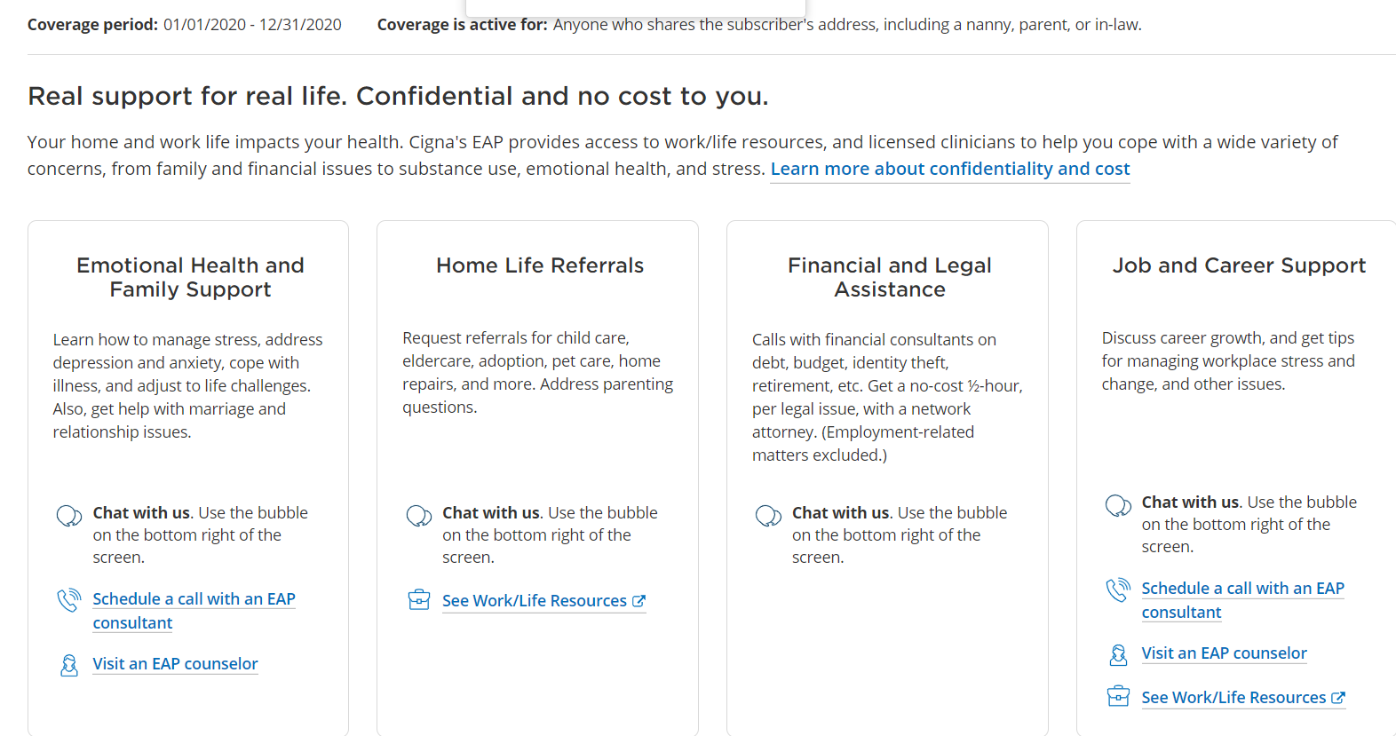
EAP Landing Page
Chat with an EAP advocate
Schedule a phone call with an EAP consultant
See online Work/Life resources available at our Work/Life Resource Center
Visit an EAP counselor

Slide 6
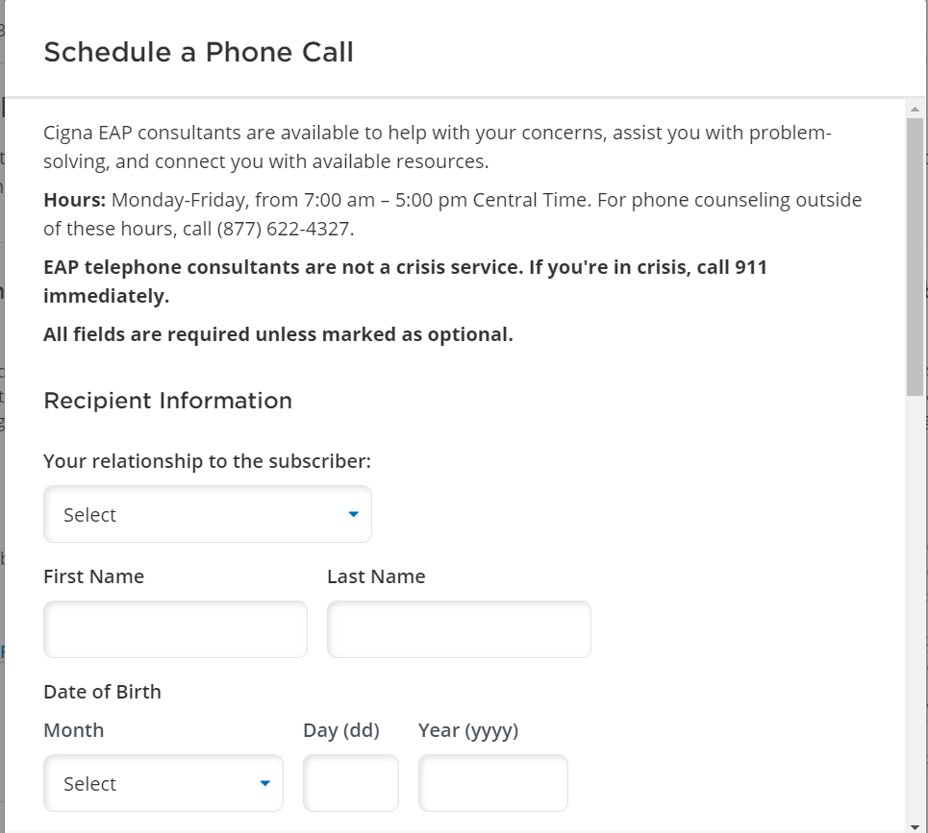
Schedule a Phone Call with an EAP Consultant
To schedule a phone call with an EAP consultant, you will need to enter all information including YOUR SSN; not the subscriber’s

Slide 7
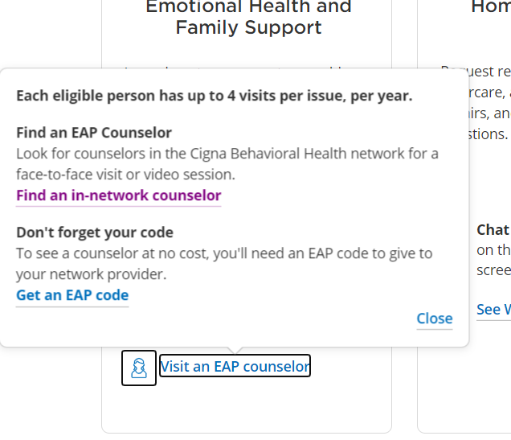
Visit an EAP Counselor
Find an in-network EAP counselor
Generate an EAP Authorization code to bring to the initial visit

Slide 8
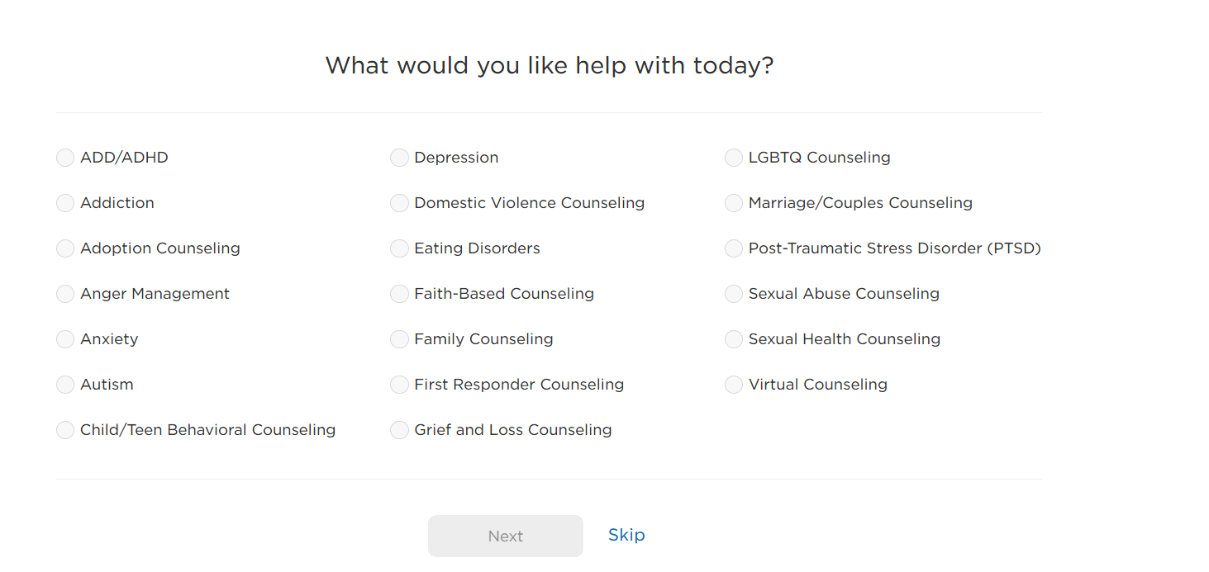
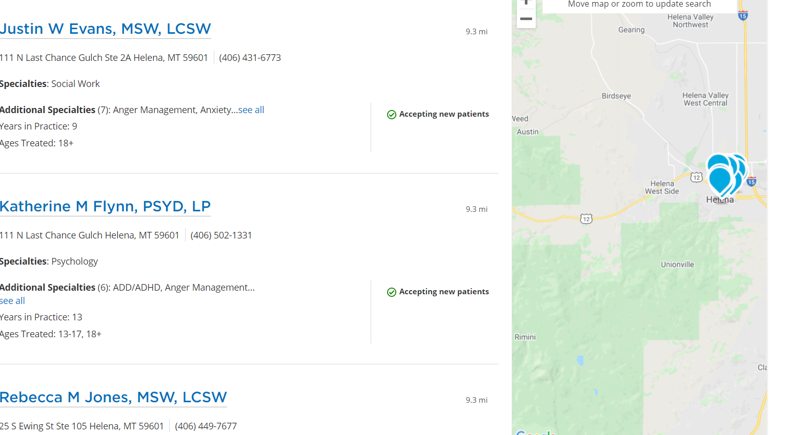
Find an in-network EAP Counselor
Choose a specialty or select ‘Skip’
List of in-network providers in your area

Slide 9
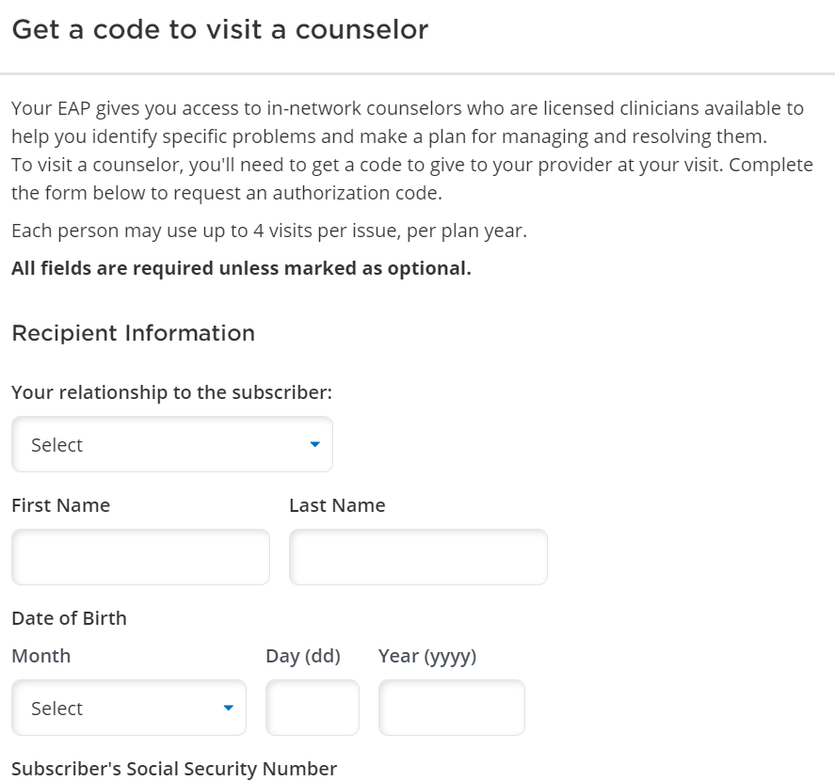
You will need to bring an Authorization Code with you to your initial visit. To generate your code online, enter all of the information on this form including YOUR SSN; not the subscriber’s
Generate an EAP Authorization Code

Slide 10
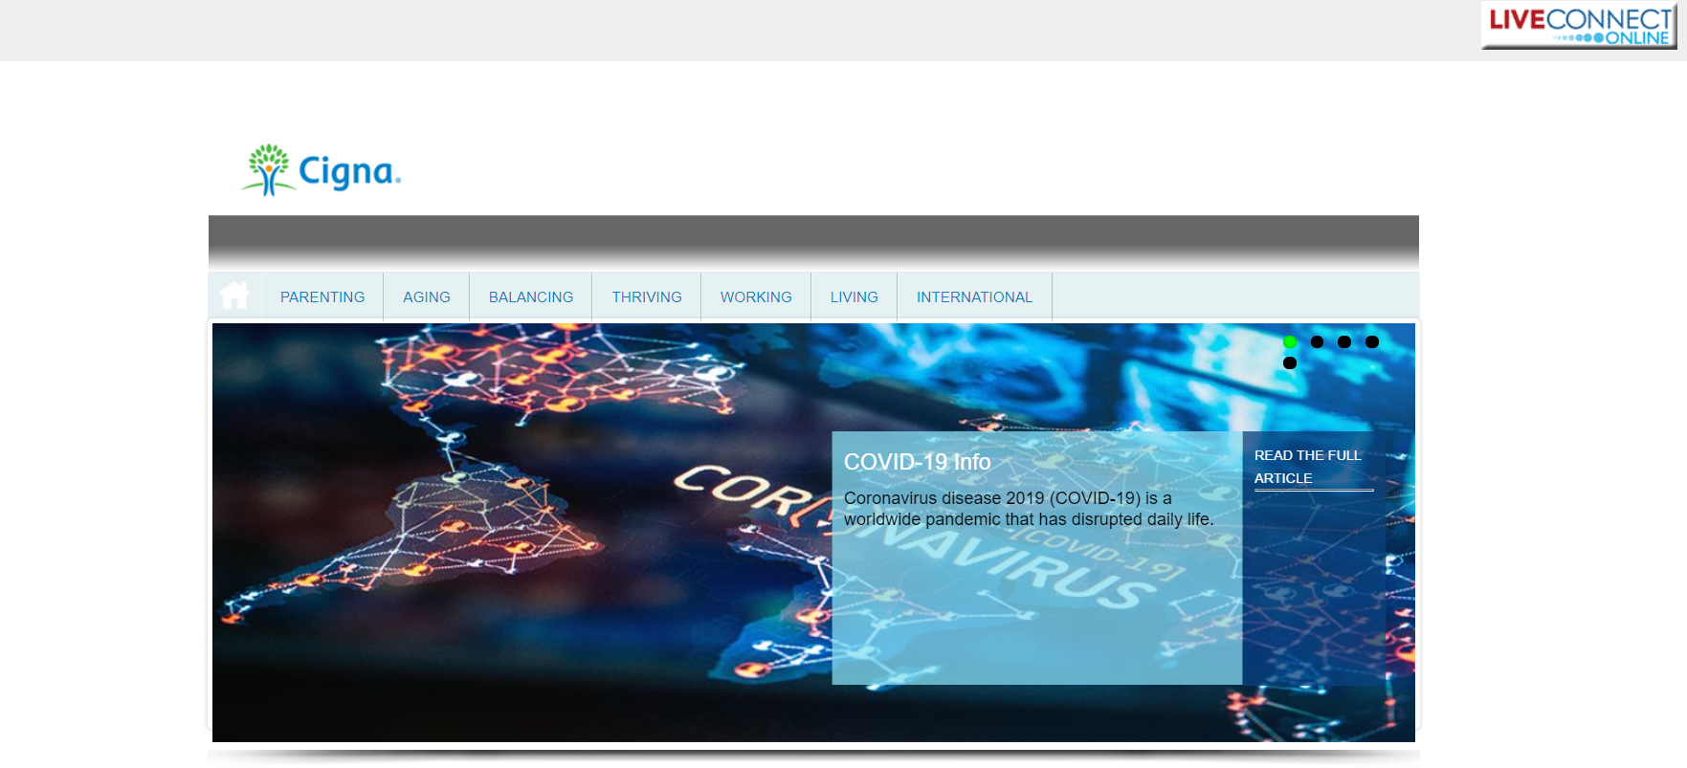
Visit the Work/Life Resource Center
Find articles, checklists, online learning and more resources on a number of different topics

Slide 11
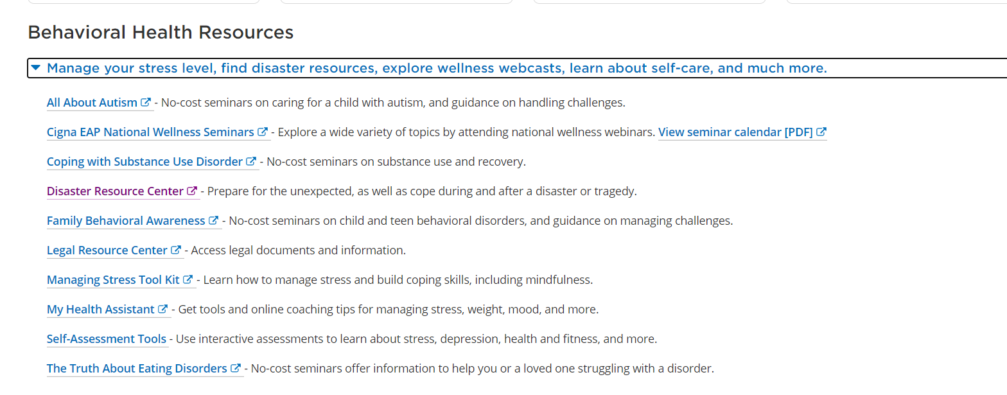
Behavioral Health Tools and Resources

Slide 12
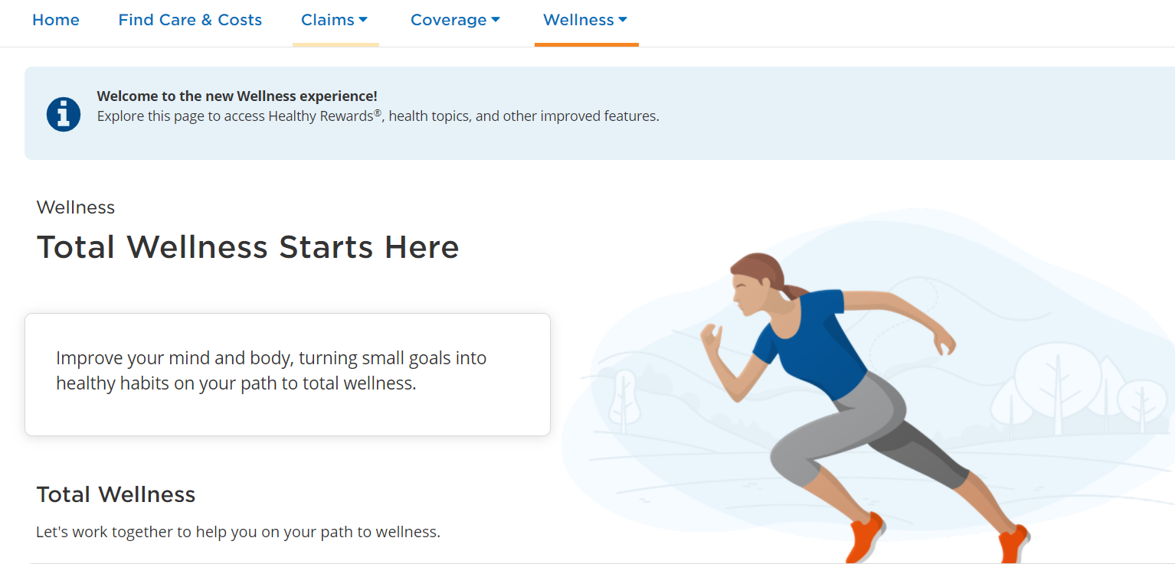
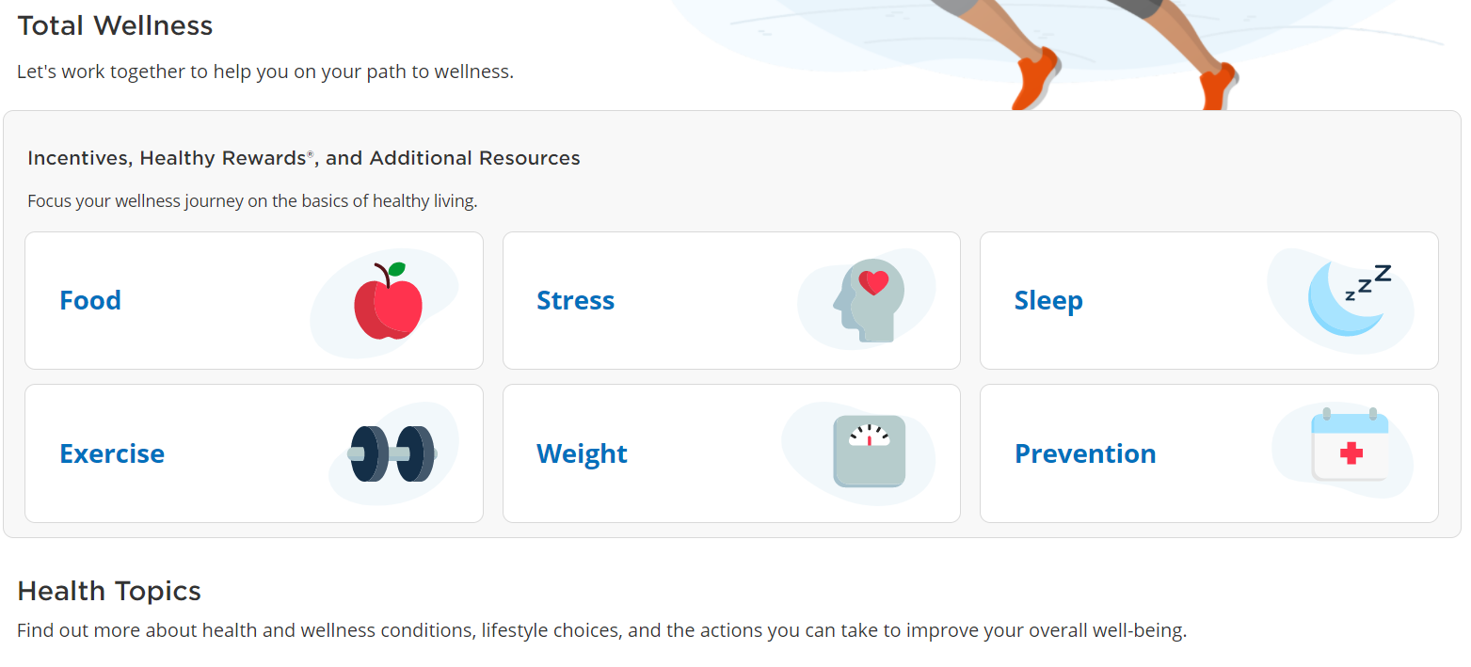
Wellness tab
Find incentive programs and discounts on a number of different wellness topics
Articles and resources for overall well-being including heart health and healthy aging

